Slide 1
Web Search and Mining
Lecture 1: Web Search Overview & Web Crawling

Slide 2
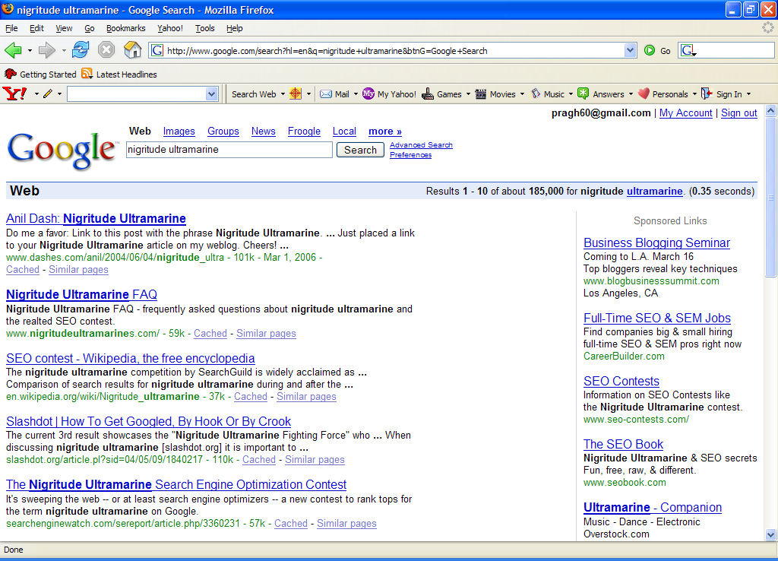
Paid
Search Ads
Algorithmic results.

Slide 3
Search and Information Retrieval
Search & IR
Search on the Web is a daily activity for many people throughout the world
Search and communication are most popular uses of the computer
Applications involving search are everywhere
The field of computer science that is most involved with R&D for search is information retrieval (IR)

Slide 4
Information Retrieval
IR
“Information retrieval is a field concerned with the structure, analysis, organization, storage, searching, and retrieval of information.” (Salton, 1968)
General definition that can be applied to many types of information and search applications
Primary focus of IR since the 50s has been on text and documents

Slide 5
What is a Document?
IR
Examples:
  web pages, email, books, news stories, scholarly papers, text messages, Word™, Powerpoint™, PDF, forum postings, patents, etc.
Common properties
  Significant text content
  Some structure (e.g., title, author, date for papers; subject, sender, destination for email)

Slide 6
Documents vs. Database Records
IR
Database records (or tuples in relational databases) are typically made up of well-defined fields (or attributes)
  e.g., bank records with account numbers, balances, names, addresses, social security numbers, dates of birth, etc.
Easy to compare fields with well-defined semantics to queries in order to find matches
Text is more difficult

Slide 7
Documents vs. Records
IR
Example bank database query
  Find records with balance > $50,000 in branches located in Amherst, MA.
  Matches easily found by comparison with field values of records
Example search engine query
  bank scandals in western mass
  This text must be compared to the text of entire news stories

Slide 8
Comparing Text
IR
Comparing the query text to the document text and determining what is a good match is the core issue of information retrieval
Exact matching of words is not enough
  Many different ways to write the same thing in a “natural language” like English
  e.g., does a news story containing the text “bank director in Amherst steals funds” match the query?
  Some stories will be better matches than others

Slide 9
Dimensions of IR
IR
IR is more than just text, and more than just web search
  although these are central
People doing IR work with different media, different types of search applications, and different tasks

Slide 10
Other Media
IR
New applications increasingly involve new media
  e.g., video, photos, music, speech
Like text, content is difficult to describe and compare
  text may be used to represent them (e.g. tags)
IR approaches to search and evaluation are appropriate

Slide 11
Dimensions of IR
IR
Content | Applications | Tasks
Text | Web search | Ad hoc search
Images | Vertical search | Filtering
Video | Enterprise search | Classification
Scanned docs | Desktop search | Question answering
Audio | Forum search
Music | P2P search
 | Literature search

Slide 12
IR Tasks
IR
Ad-hoc search
  Find relevant documents for an arbitrary text query
Filtering
  Identify relevant user profiles for a new document
Classification
  Identify relevant labels for documents
Question answering
  Give a specific answer to a question

Slide 13
Big Issues in IR
IR
Relevance
  What is it?
  Simple (and simplistic) definition:
  A relevant document contains the information that a person was looking for when they submitted a query to the search engine
  Many factors influence a person’s decision about what is relevant: e.g., task, context, novelty, style
  Topical relevance (same topic) vs. user relevance (everything else)

Slide 14
Big Issues in IR
IR
Relevance
  Retrieval models define a view of relevance
  Ranking algorithms used in search engines are based on retrieval models
  Most models describe statistical properties of text rather than linguistic
    i.e., counting simple text features such as words instead of parsing and analyzing the sentences
    Statistical approach to text processing started with Luhn in the 50s
    Linguistic features can be part of a statistical model

Slide 15
Big Issues in IR
IR
Evaluation
  Experimental procedures and measures for comparing system output with user expectations
    Originated in Cranfield experiments in the 60s
  Typically use test collection of documents, queries, and relevance judgments
    Most commonly used are TREC collections
  Recall and precision are two examples of effectiveness measures

Slide 16
Big Issues in IR
IR
Users and Information Needs
  Search evaluation is user-centered
  Keyword queries are often poor descriptions of actual information needs
  Interaction and context are important for understanding user intent
  Query refinement techniques such as query expansion, query suggestion, relevance feedback improve ranking

Slide 17
IR and Search Engines
IR
A search engine is the practical application of information retrieval techniques to large scale text collections
Web search engines are best-known examples, but many others
  Open source search engines are important for research and development
    e.g., Lucene, Lemur/Indri, Galago
Big issues include main IR issues but also some others

Slide 18
IR and Search Engines
IR
Information Retrieval
Search Engines
Performance
-Efficient search and indexing
Incorporating new data
-Coverage and freshness
Scalability
-Growing with data and users
Adaptability
-Tuning for applications
Specific problems
-e.g. Spam
Relevance
-Effective ranking
Evaluation
-Testing and measuring
Information needs
-User interaction

Slide 19
Search Engine Issues
Search Engine
Performance
  Measuring and improving the efficiency of search
    e.g., reducing response time, increasing query throughput, increasing indexing speed
  Indexes are data structures designed to improve search efficiency
    designing and implementing them are major issues for search engines

Slide 20
Search Engine Issues
Search Engine
Dynamic data (Incorporating new data)
  The “collection” for most real applications is constantly changing in terms of updates, additions, deletions
    e.g., web pages
  Acquiring or “crawling” the documents is a major task
    Typical measures are coverage (how much has been indexed) and freshness (how recently was it indexed)
  Updating the indexes while processing queries is also a design issue

Slide 21
Search Engine Issues
Search Engine
Scalability
  Making everything work with millions of users every day, and many terabytes of documents
  Distributed processing is essential
Adaptability
  Changing and tuning search engine components such as ranking algorithm, indexing strategy, interface for different applications

Slide 22
Search Engine Issues
Search Engine
Spam
  For Web search, spam in all its forms is one of the major issues
  Affects the efficiency of search engines and, more seriously, the effectiveness of the results
  Many types of spam
    e.g. spamdexing or term spam, link spam, “optimization”
  New subfield called adversarial IR, since spammers are “adversaries” with different goals

Slide 23
Architecture of SE
Search Engine
How do search engines like Google work?

Slide 24
Search Engine
Paid
Search Ads
Algorithmic results.

Slide 25

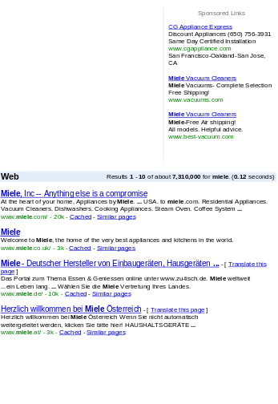

Architecture
Search Engine
User
Web spider
Search
Indexer
The Web
Indexes
Ad indexes

Slide 26
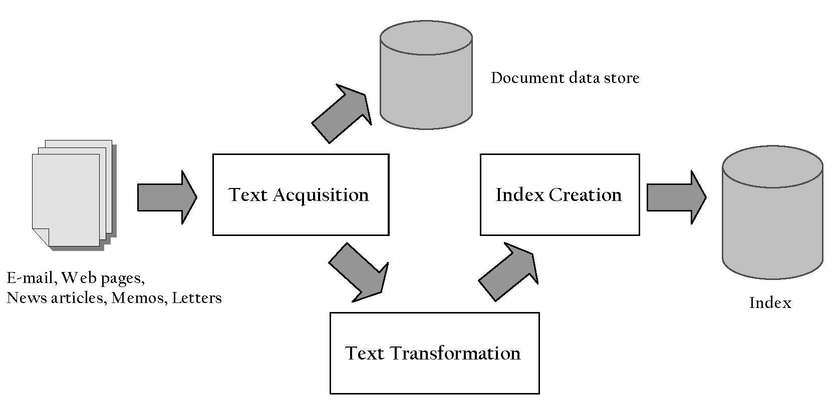
Indexing Process
Search Engine

Slide 27
Indexing Process
Search Engine
Text acquisition
  identifies and stores documents for indexing
Text transformation
  transforms documents into index terms or features
Index creation
  takes index terms and creates data structures (indexes) to support fast searching

Slide 28
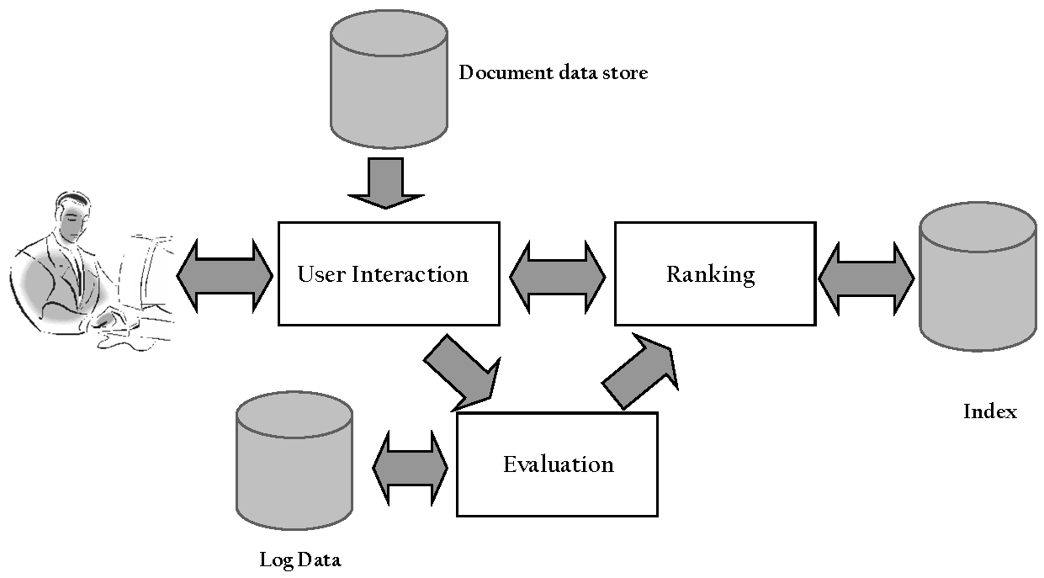
Query Process
Search Engine

Slide 29
Query Process
Search Engine
User interaction
  supports creation and refinement of query, display of results
Ranking
  uses query and indexes to generate ranked list of documents
Evaluation
  monitors and measures effectiveness and efficiency (primarily offline)

Slide 30
Details: Text Acquisition
Indexing Process
Crawler
  Identifies and acquires documents for search engine
  Many types – web, enterprise, desktop
  Web crawlers follow links to find documents
    Must efficiently find huge numbers of web pages (coverage) and keep them up-to-date (freshness)
    Single site crawlers for site search
    Topical or focused crawlers for vertical search
  Document crawlers for enterprise and desktop search
    Follow links and scan directories

Slide 31
Web Crawler
Indexing Process
Starts with a set of seeds, which are a set of URLs given to it as parameters
Seeds are added to a URL request queue
Crawler starts fetching pages from the request queue
Downloaded pages are parsed to find link tags that might contain other useful URLs to fetch
New URLs added to the crawler’s request queue, or frontier
Continue until no more new URLs or disk full

Slide 32
Crawling picture
Indexing Process
URLs crawled
and parsed
Unseen Web
Seed
pages
URLs frontier
Web

Slide 33
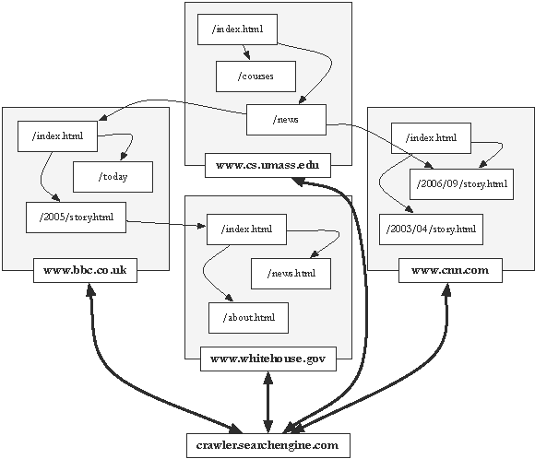
Crawling the Web
Indexing Process

Slide 34
Text Acquisition
Indexing Process
Feeds
  Real-time streams of documents
    e.g., web feeds for news, blogs, video, radio, tv
  RSS is common standard
    RSS “reader” can provide new XML documents to search engine
Conversion
  Convert variety of documents into a consistent text plus metadata format
    e.g. HTML, XML, Word, PDF, etc. → XML
  Convert text encoding for different languages
    Using a Unicode standard like UTF-8

Slide 35
Text Acquisition
Indexing Process
Document data store
  Stores text, metadata, and other related content for documents
    Metadata is information about document such as type and creation date
    Other content includes links, anchor text
  Provides fast access to document contents for search engine components
    e.g. result list generation
  Could use relational database system
    More typically, a simpler, more efficient storage system is used due to huge numbers of documents

Slide 36
Text Transformation
Indexing Process
Parser
  Processing the sequence of text tokens in the document to recognize structural elements
    e.g., titles, links, headings, etc.
  Tokenizer recognizes “words” in the text
    must consider issues like capitalization, hyphens, apostrophes, non-alpha characters, separators
  Markup languages such as HTML, XML often used to specify structure
    Tags used to specify document elements
      E.g., <h2> Overview </h2>
    Document parser uses syntax of markup language (or other formatting) to identify structure

Slide 37
Text Transformation
Indexing Process
Stopping
  Remove common words
    e.g., “and”, “or”, “the”, “in”
  Some impact on efficiency and effectiveness
  Can be a problem for some queries
Stemming
  Group words derived from a common stem
    e.g., “computer”, “computers”, “computing”, “compute”
  Usually effective, but not for all queries
  Benefits vary for different languages

Slide 38
Text Transformation
Indexing Process
Link Analysis
  Makes use of links and anchor text in web pages
  Link analysis identifies popularity and community information
    e.g., PageRank
  Anchor text can significantly enhance the representation of pages pointed to by links
  Significant impact on web search

Slide 39
Text Transformation
Indexing Process
Information Extraction
  Identify classes of index terms that are important for some applications
  e.g., named entity recognizers identify classes such as people, locations, companies, dates, etc.
Classifier
  Identifies class-related metadata for documents
    i.e., assigns labels to documents
    e.g., topics, reading levels, sentiment, genre
  Use depends on application

Slide 40
Index Creation
Indexing Process
Document Statistics
  Gathers counts and positions of words and other features
  Used in ranking algorithm
Weighting
  Computes weights for index terms
  Used in ranking algorithm
  e.g., tf.idf weight
    Combination of term frequency in document and inverse document frequency in the collection

Slide 41
Index Creation
Indexing Process
Inversion
  Core of indexing process
  Converts document-term information to term-document for indexing
    Difficult for very large numbers of documents
  Format of inverted file is designed for fast query processing
    Must also handle updates
    Compression used for efficiency

Slide 42
Index Creation
Indexing Process
Index Distribution
  Distributes indexes across multiple computers and/or multiple sites
  Essential for fast query processing with large numbers of documents
  Many variations
    Document distribution, term distribution, replication
  P2P and distributed IR involve search across multiple sites

Slide 43
User Interaction
Query Process
Query input
  Provides interface and parser for query language
  Most web queries are very simple, other applications may use forms
  Query language used to describe more complex queries and results of query transformation
    e.g., Boolean queries
    similar to SQL language used in database applications
    IR query languages also allow content and structure specifications, but focus on content

Slide 44
User Interaction
Query Process
Query transformation
  Improves initial query, both before and after initial search
  Includes text transformation techniques used for documents
  Spell checking and query suggestion provide alternatives to original query
  Query expansion and relevance feedback modify the original query with additional terms

Slide 45
User Interaction
Query Process
Results output
  Constructs the display of ranked documents for a query
  Generates snippets to show how queries match documents
  Highlights important words and passages
  Retrieves appropriate advertising in many applications
  May provide clustering and other visualization tools

Slide 46
Ranking
Query Process
Scoring
  Calculates scores for documents using a ranking algorithm
  Core component of search engine
  Basic form of score is ∑ q_{i} d_{i}
    q_{i} and d_{i} are query and document term weights for term i
  Many variations of ranking algorithms and retrieval models

Slide 47
Ranking
Query Process
Performance optimization
  Designing ranking algorithms for efficient processing
    Term-at-a time vs. document-at-a-time processing
    Safe vs. unsafe optimizations
Distribution
  Processing queries in a distributed environment
  Query broker distributes queries and assembles results
  Caching is a form of distributed searching

Slide 48
Evaluation
Query Process
Logging
  Logging user queries and interaction is crucial for improving search effectiveness and efficiency
  Query logs and clickthrough data used for query suggestion, spell checking, query caching, ranking, advertising search, and other components
Ranking analysis
  Measuring and tuning ranking effectiveness
Performance analysis
  Measuring and tuning system efficiency

Slide 49
How Does It Really Work?
This course explains these components of a search engine in more detail
Often many possible approaches and techniques for a given component
  Focus is on the most important alternatives
  i.e., explain a small number of approaches in detail rather than many approaches
  “Importance” based on research results and use in actual search engines
  Alternatives described in references

Slide 50
More resources
IIR Chapters 19 and 20
SE Chapters 1-3

